Slide 1
PFAS – Public Drinking Water
Doug Kinard, Director
Drinking Water & Recreational Waters Protection Division

Slide 2



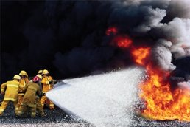







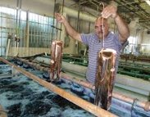
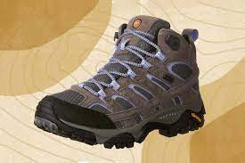


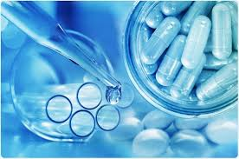

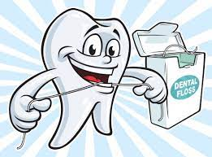
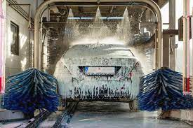
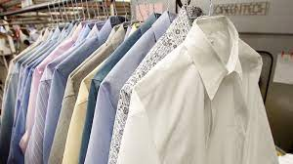
WHERE is PFAS? Everywhere

Slide 3
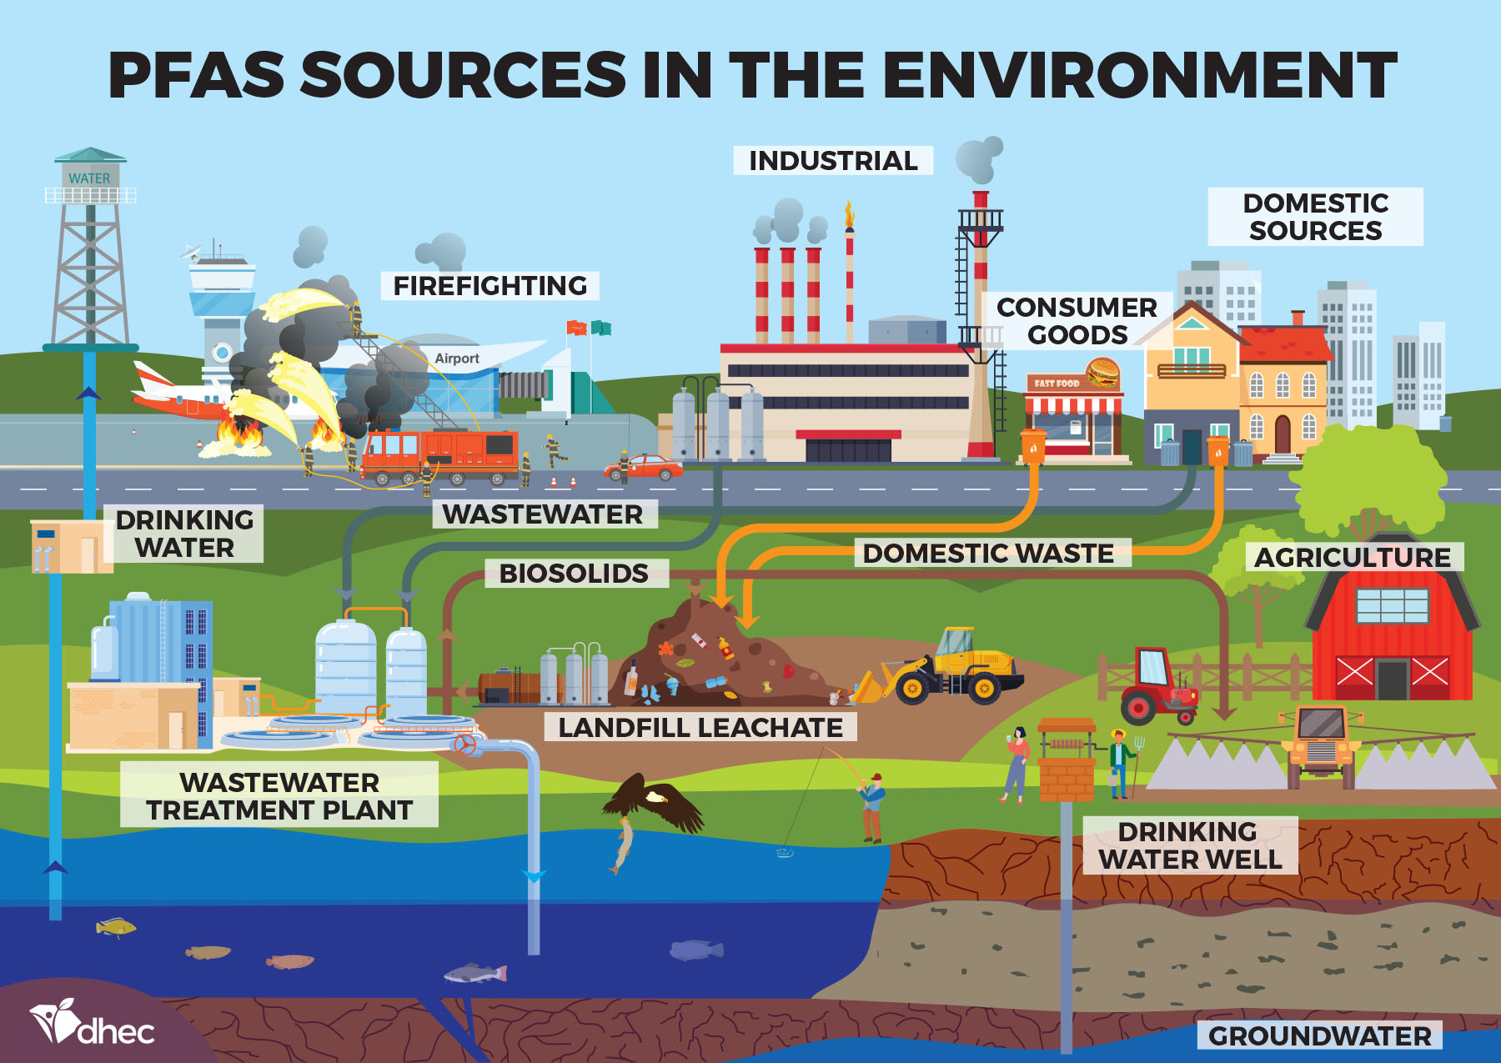

Slide 4
PFAS in SC - History
Unregulated Contaminant Monitoring Rule 3 (UCMR3)
  2013 – 2015
  75 large (>10K) and select small systems (493 total samples)
  1 single detect
  We were golden.
National Conferences
  Heard from other states with big PFAS problems
  UCM3 detection limits were too high
  Started to doubt our goldenness
Relayed our concerns to Upper Management

Slide 5
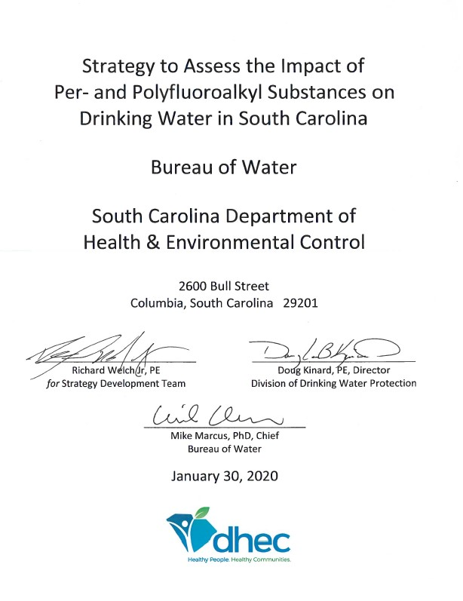
PFAS in SC - History
PFAS Drinking Water Strategy
  Primary Author – Kyle Mauer
  Goal to sample all community water systems sources in state (about 1000)
  Phase 1- 2020 & 2021
    All surface water treatment plants
    Larger ground water systems
    Total of 113 systems sampled (377 sources)
  Phase 2 – 2022 & 2023
    Remaining small ground water systems
    About 600 sources in Phase 2
  Strategy and sample results for Phase 1 are available on the DHEC website

Slide 6
PFAS Drinking Water Strategy
Phase 1 (2020 & 2021)
  55 surface water sources (SW plants & additional wells)
  53 large ground water sources ( 322 sources)
  Covered 3.9 million people served by CWS (95%)
Phase 2 (2022 & 2023)
  Remaining small ground water system sources (~600)
  Still a few remaining to be sampled
  Results to be posted to our website when data set is complete

Slide 7
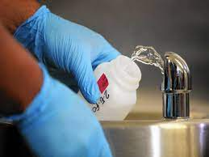
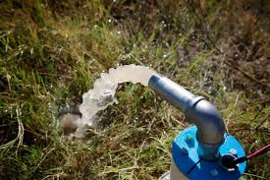
PFAS Monitoring Data Limitations
Based on a single sample
A handful of small systems yet to be sampled or awaiting lab results

Slide 8
Data Summary PFOA & PFOS
Surface Water Plants – PFOA and/or PFOS
  25 of 56 sources have results over 4 ppt (44.6%)
  2 sources have results between 10 ppt and 20 ppt
  No results above 20 ppt
Ground Water Sources – PFOA and/or PFOS
  46 of 878 sources have results over 4 ppt (5.2%)
  2 sources have PFOA or PFOS results over 100 ppt
  Data does not include water systems impacted by Shaw AFB

Slide 9
Other DHEC DW Actions on PFAS
Media Briefing - February 27, 2023
  Focused on PFAS in drinking water
  Educate media about PFAS ahead of EPA’s expected proposed PFAS drinking water regulation
Media Briefing – March 12, 2023
  Focused on proposed MCL and potential impacts to public water systems in the state
Third focused on ambient monitoring
Fourth this Friday focused on private wells

Slide 10
Contact Information
Doug Kinard
SCDHEC - Bureau of Water
2600 Bull Street
Columbia, SC 29201
Phone (803) 898-3543
email: doug.kinard@dhec.sc.gov

